Slide 1
Not blockbusters, Still Hollywood
Jonathan Chu

Slide 2
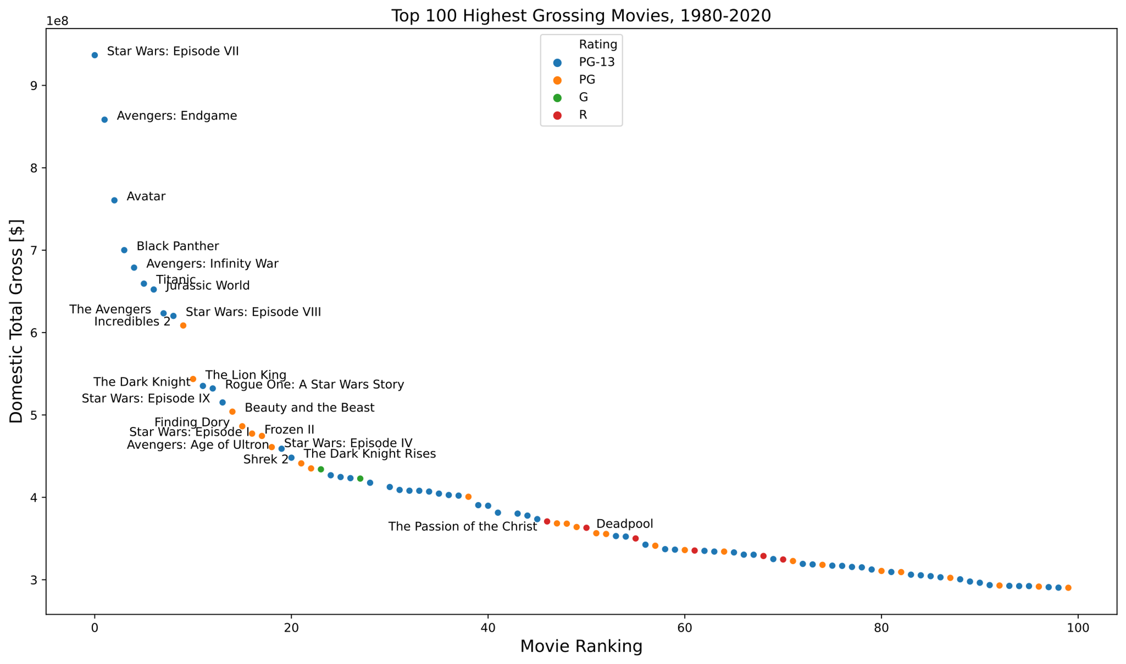
Hollywood is a big deal
But nobody records their budget
20% of films in past 40 years have no budget

Slide 3
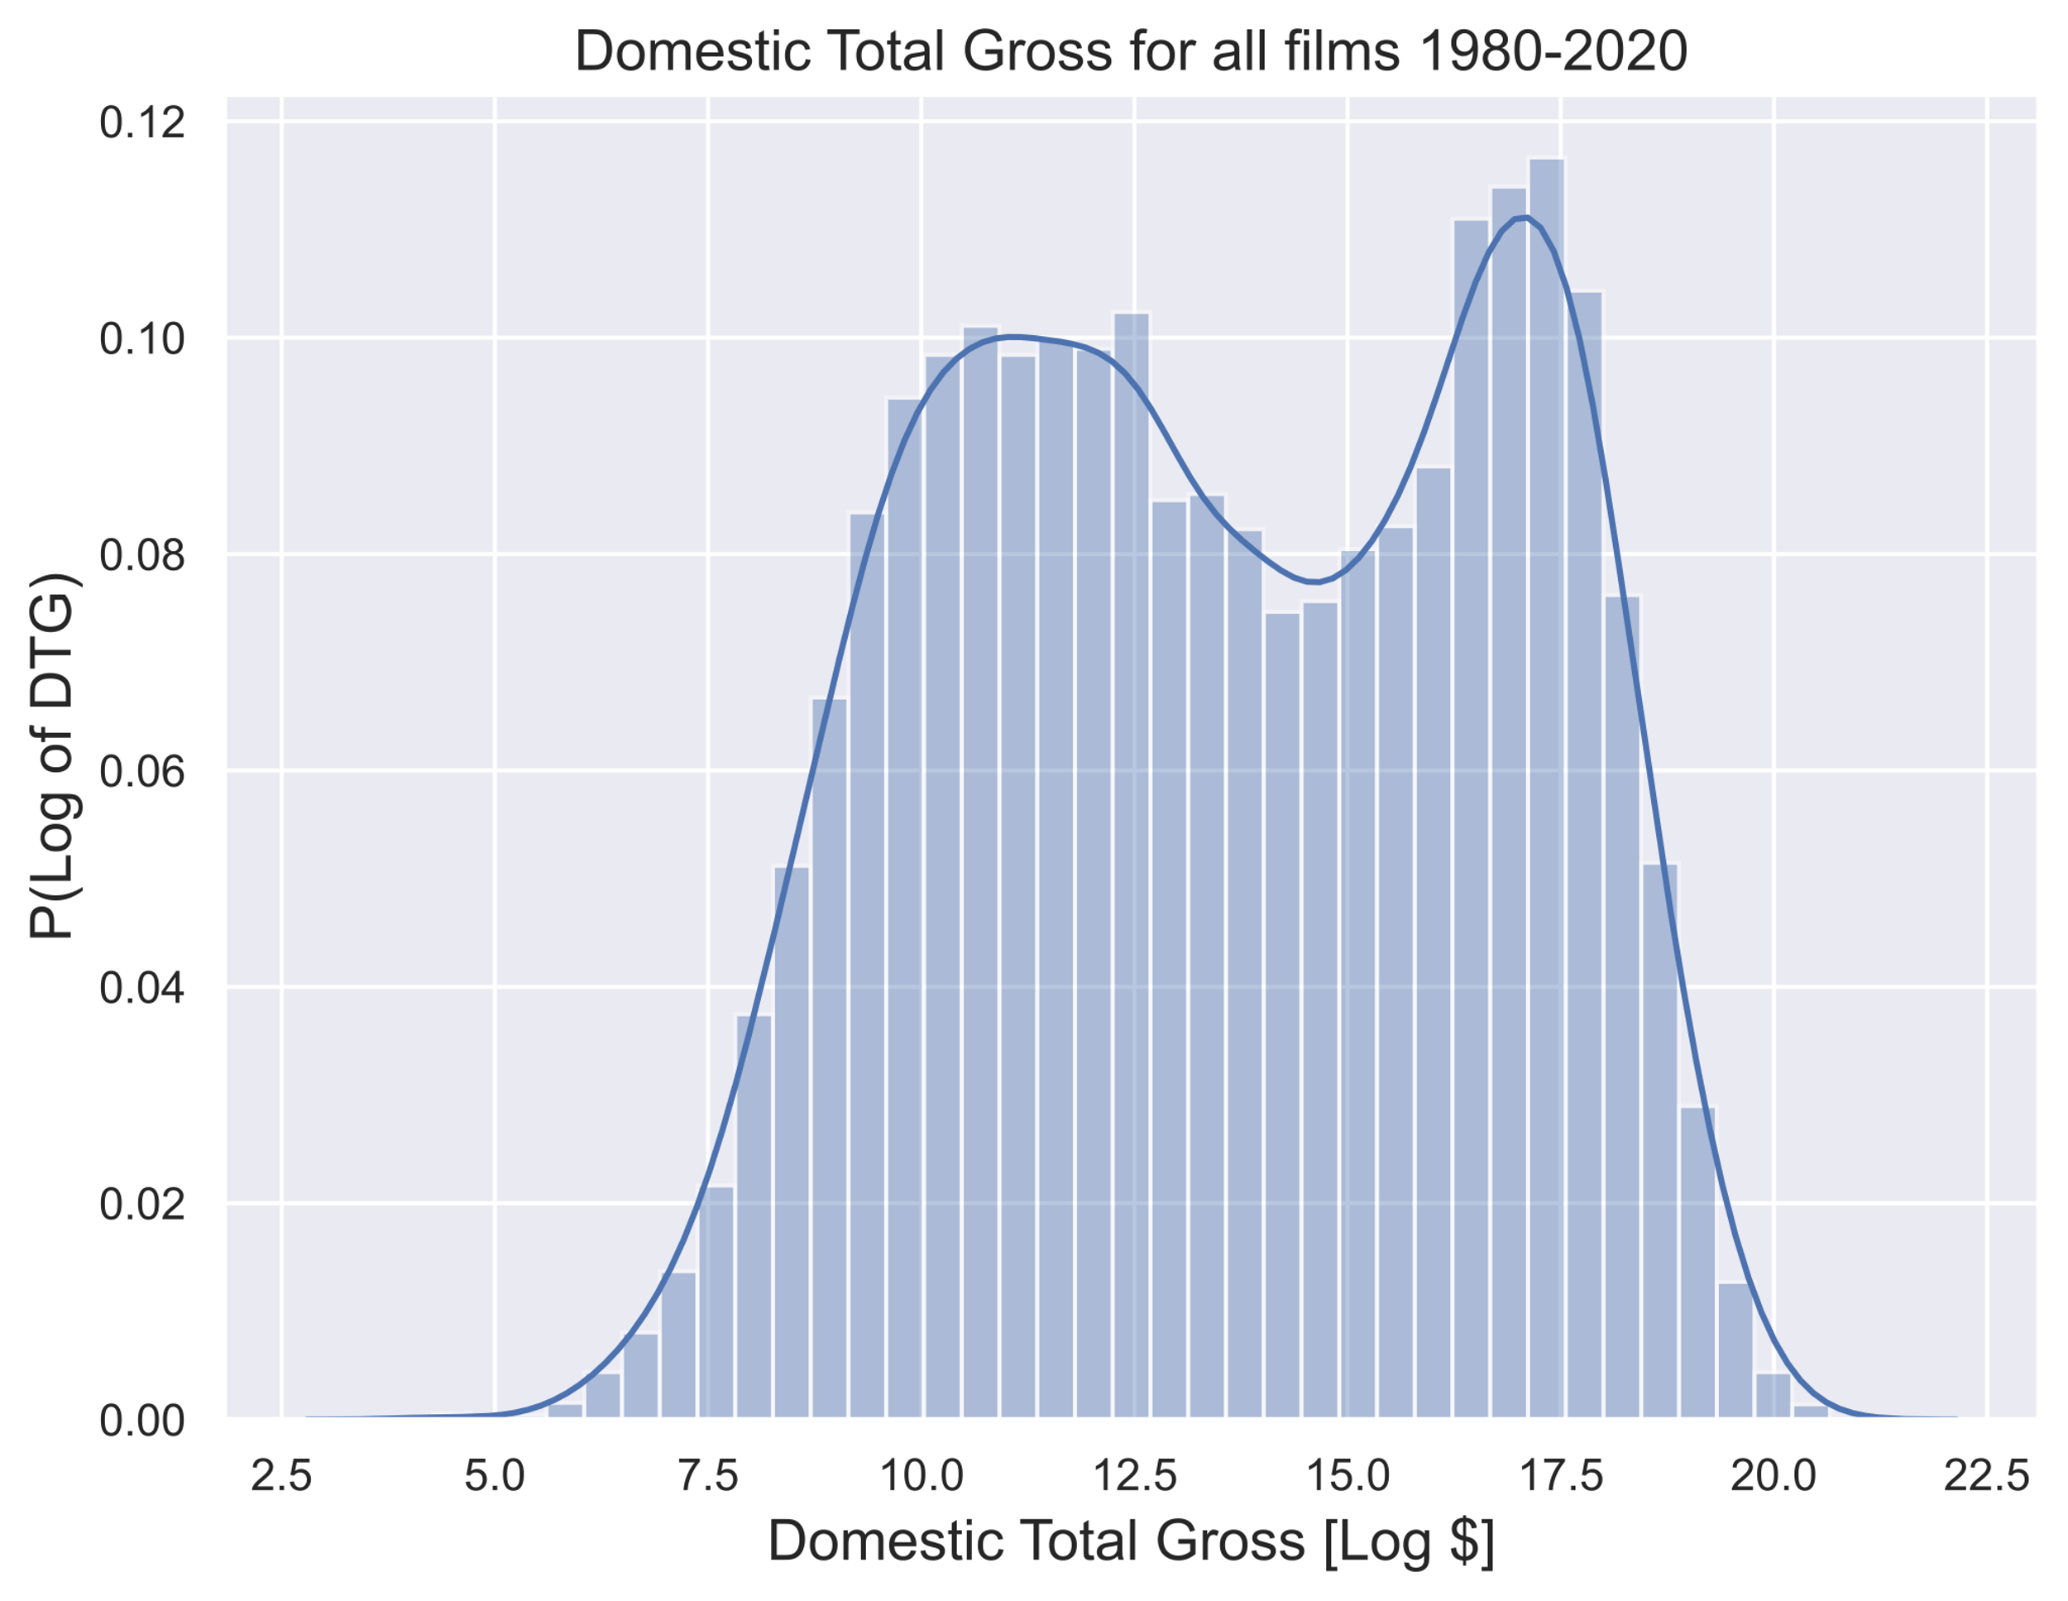
medium fish only
$1M
$250M
Gross between $1 and $250 million
Budgets > $1 million

Slide 4

Scoring Impact
How to gauge box-office power
of people?
Take median of previous film grosses

Slide 5
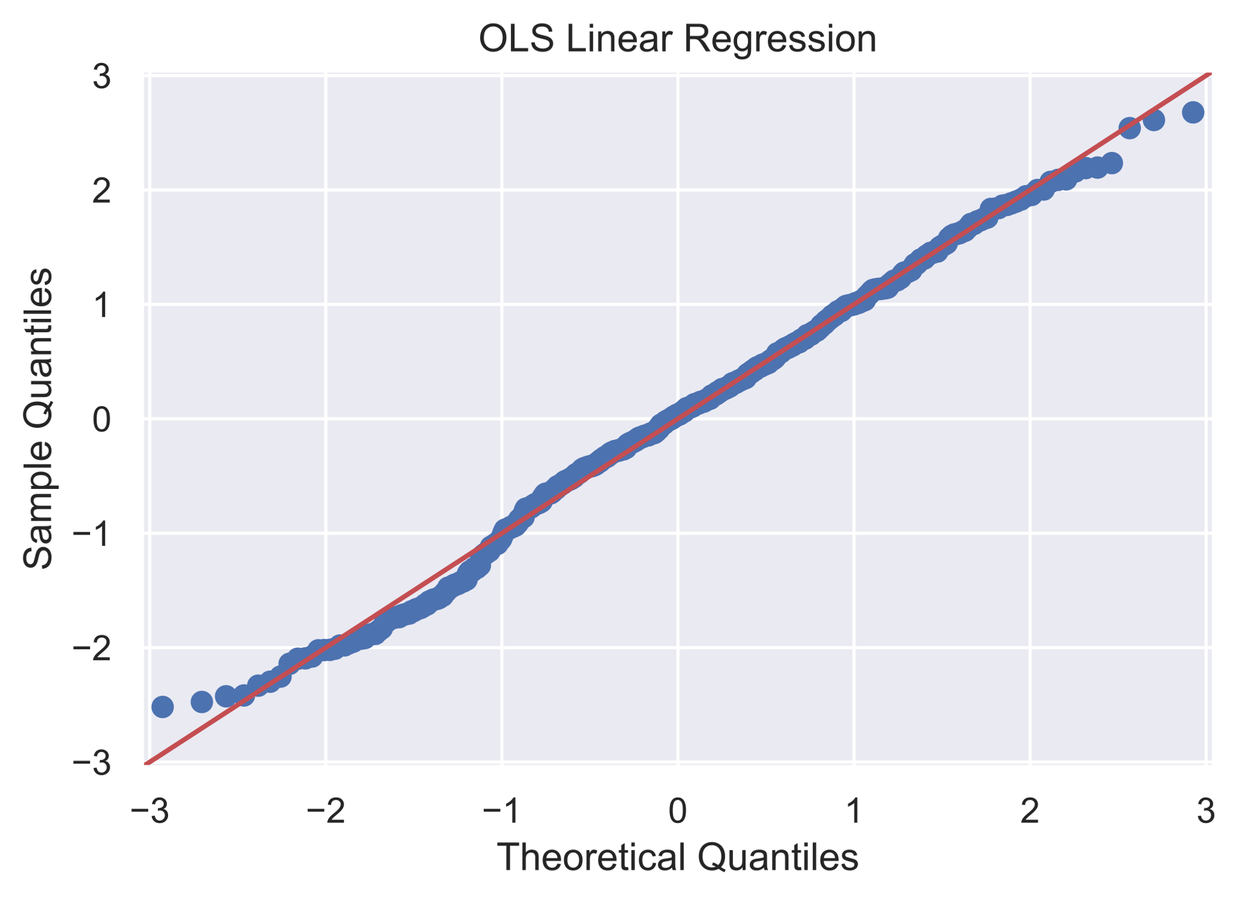
Results
OLS Poly
R² | 0.332
Adj R² | 0.327
MAE | $28.6M
RMSE | $1.75M

Slide 6
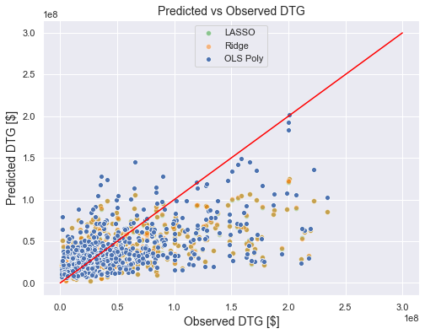
Takeaways
Budget is (unsurprisingly) the most accurate predictor of gross
Also distributor (studio)

Slide 7
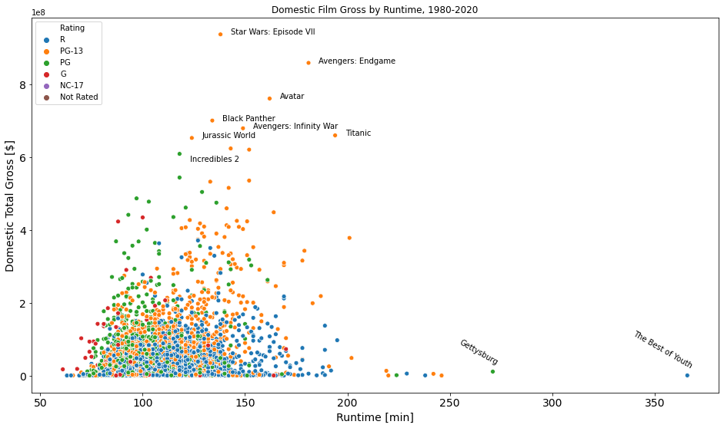
Future Work
Film festival data
Separate model for blockbusters
Predict budget from other params

Slide 8
Appendix

Slide 9
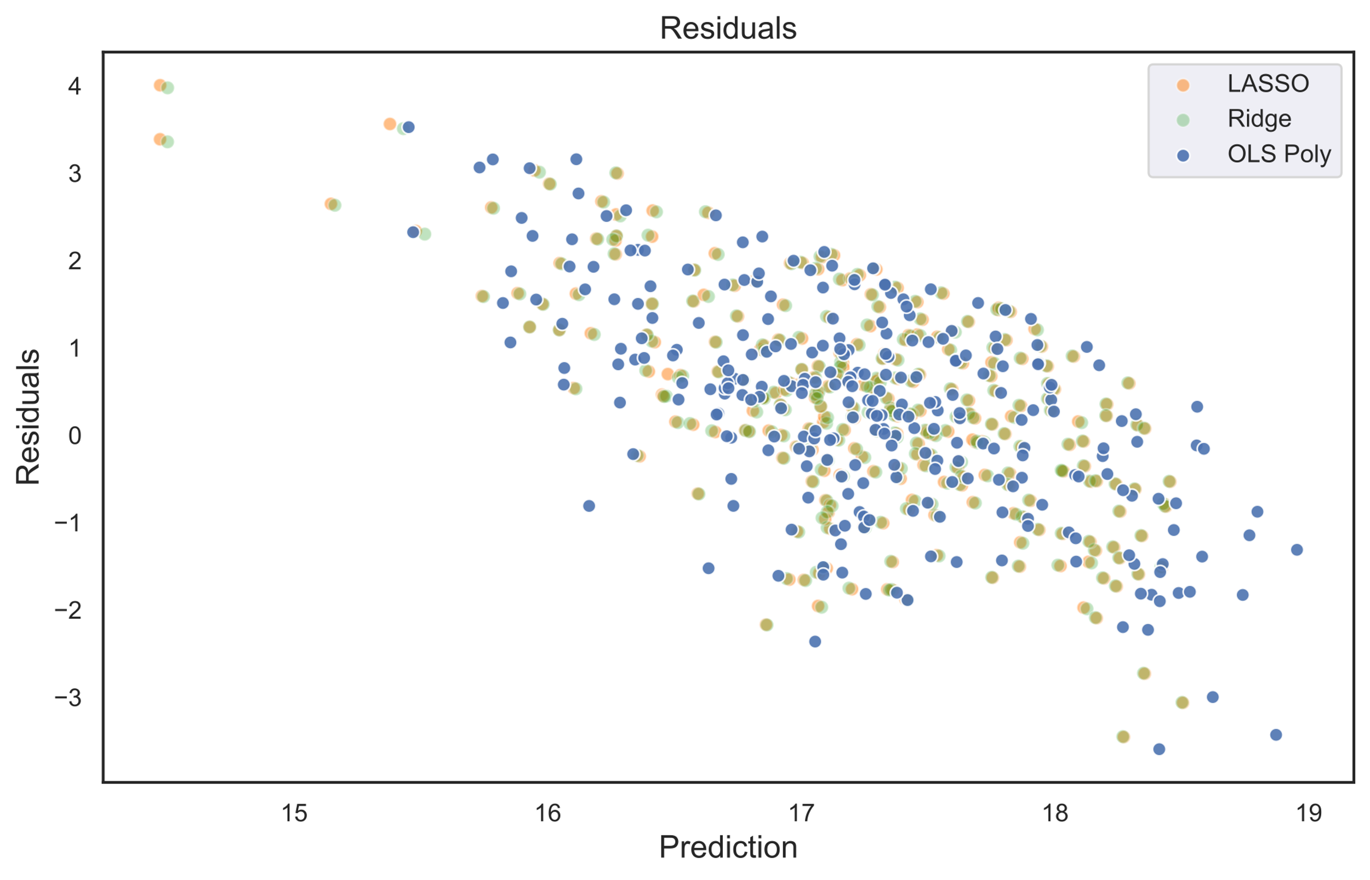

Slide 10
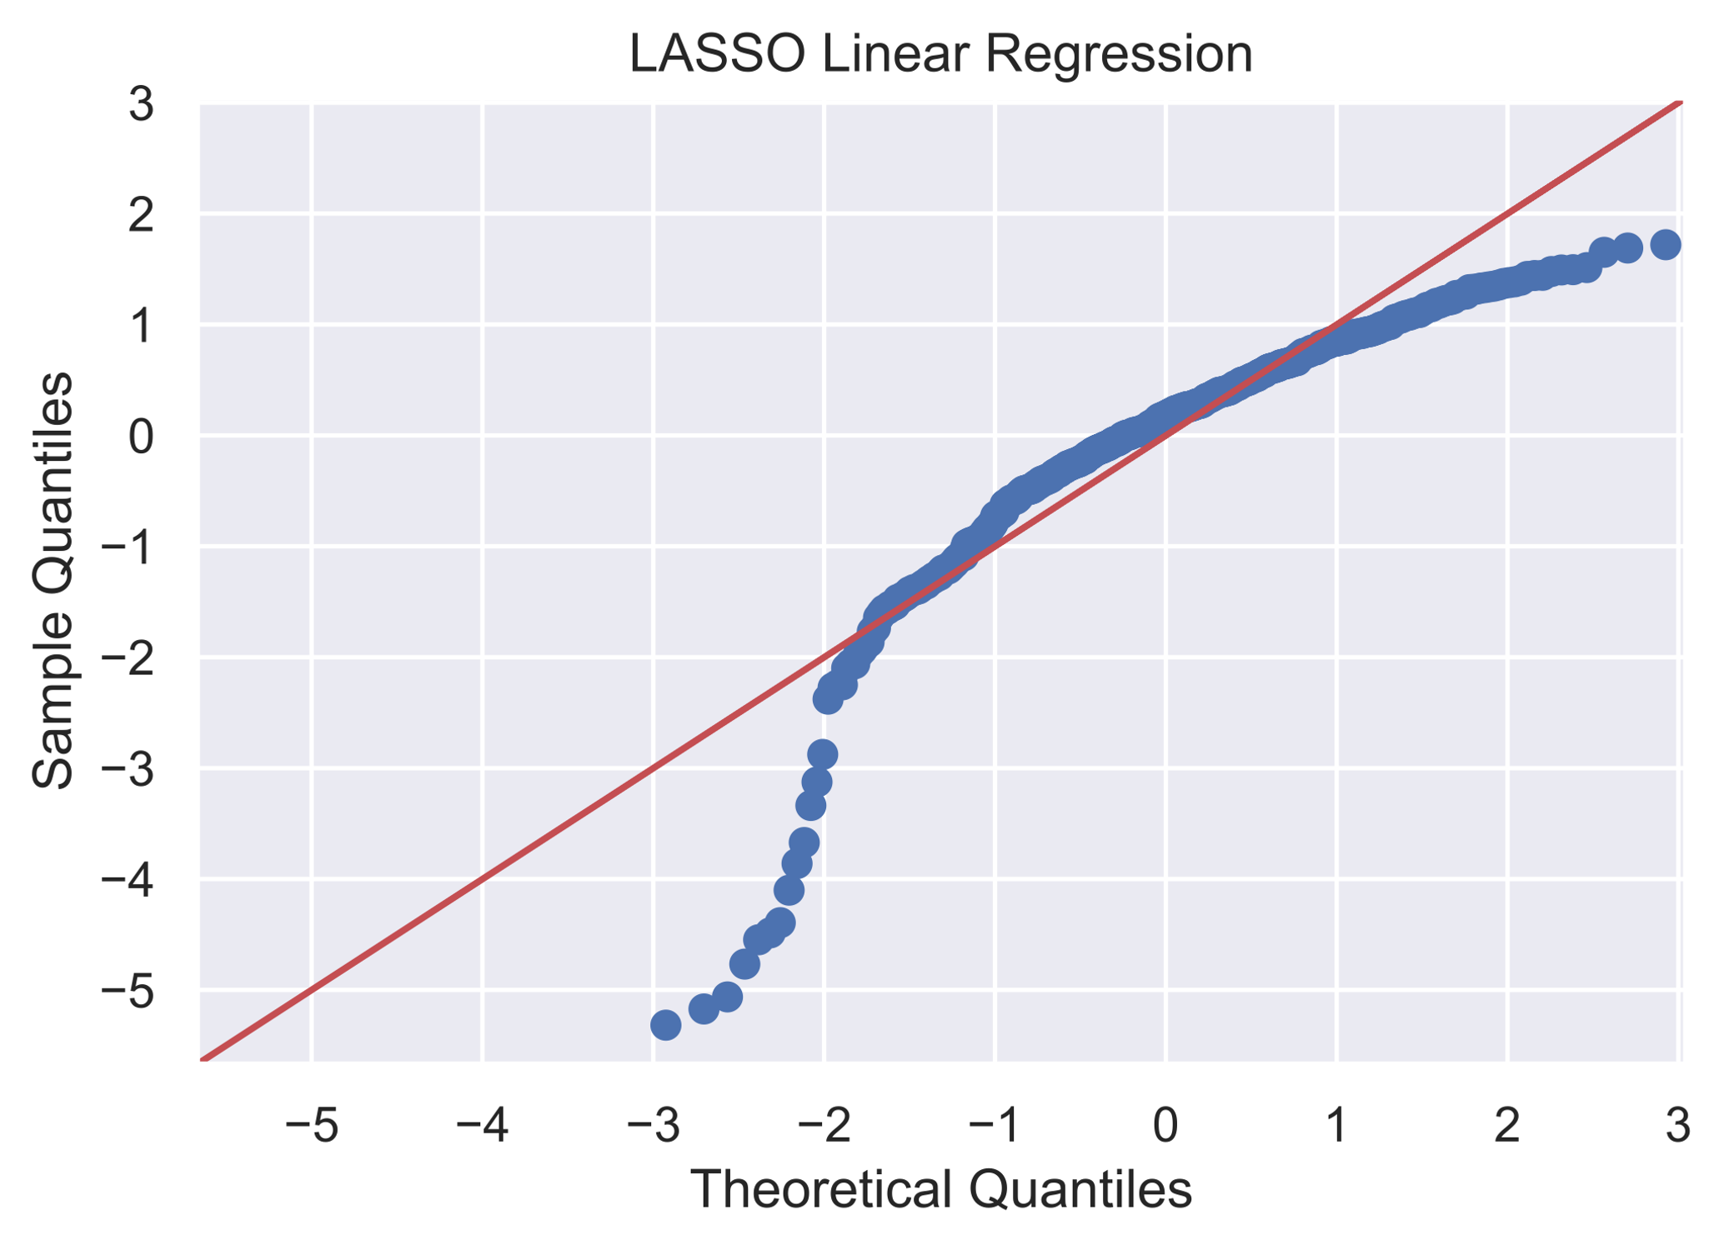
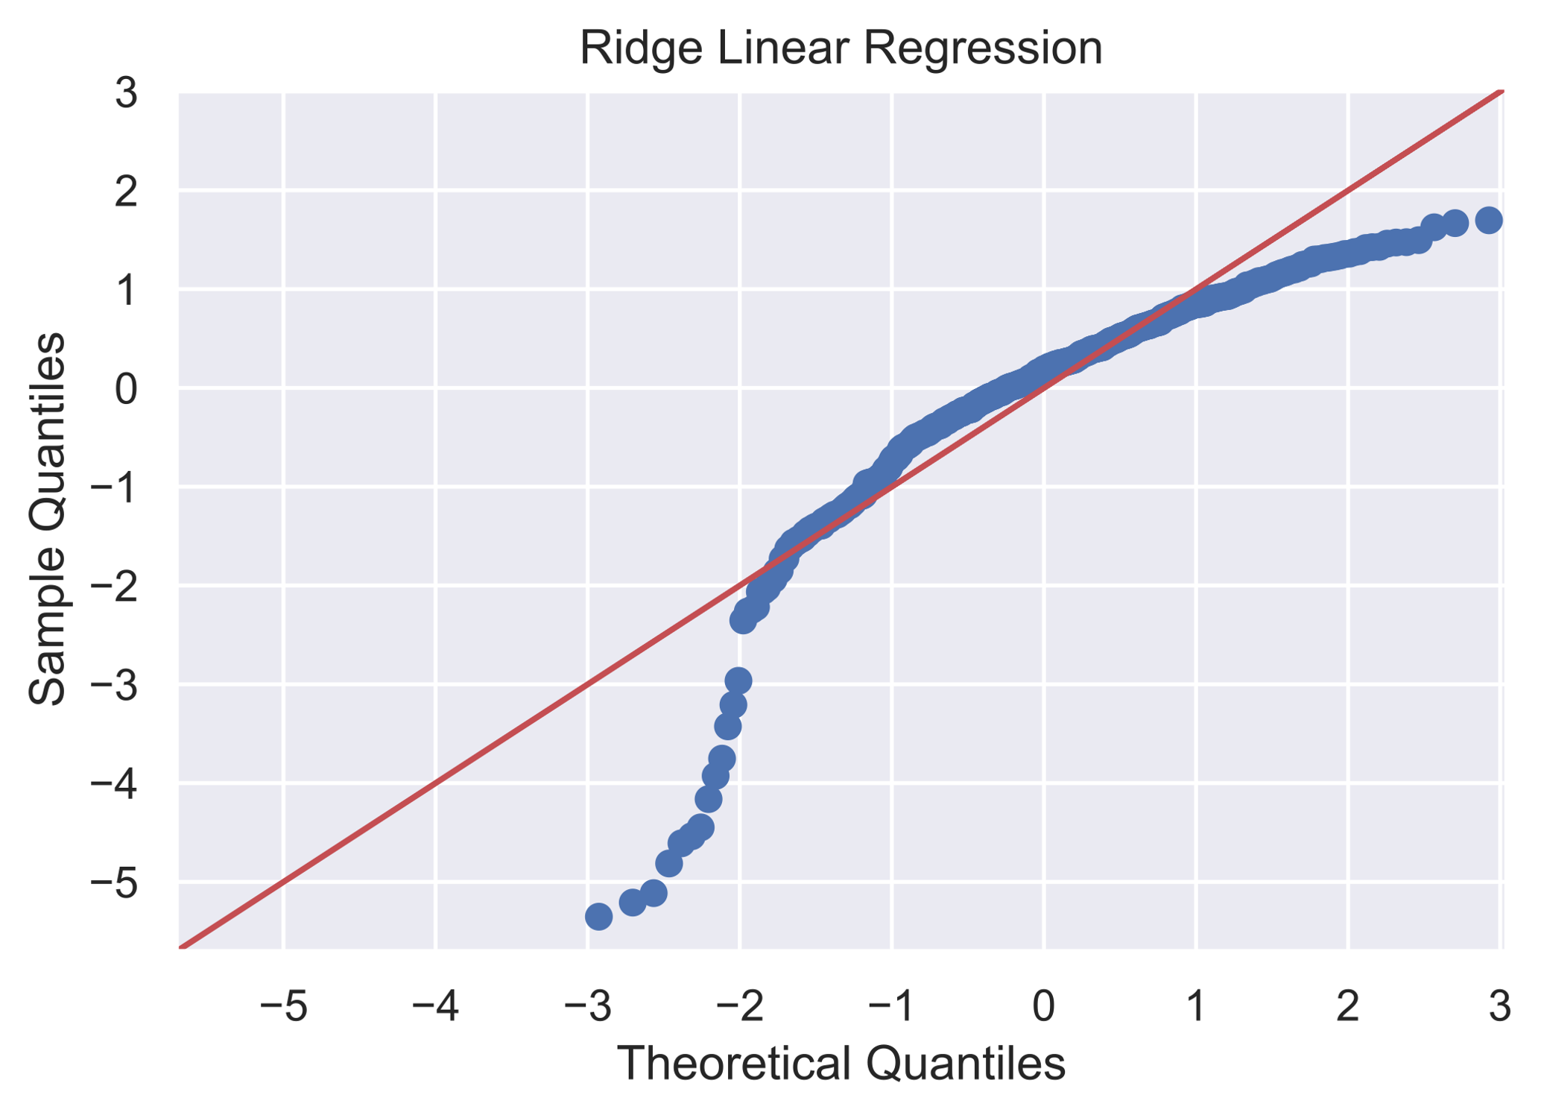
LASSO & Ridge regressions

Slide 11
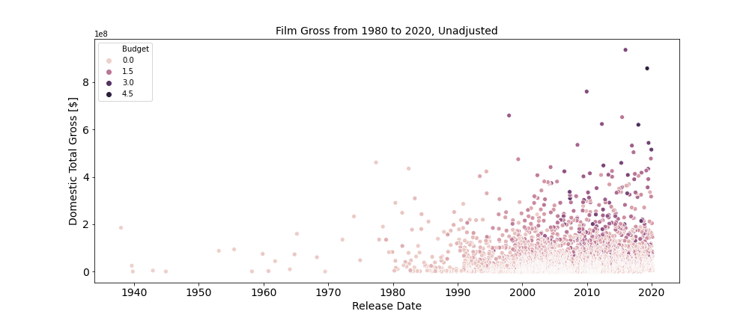

Slide 12
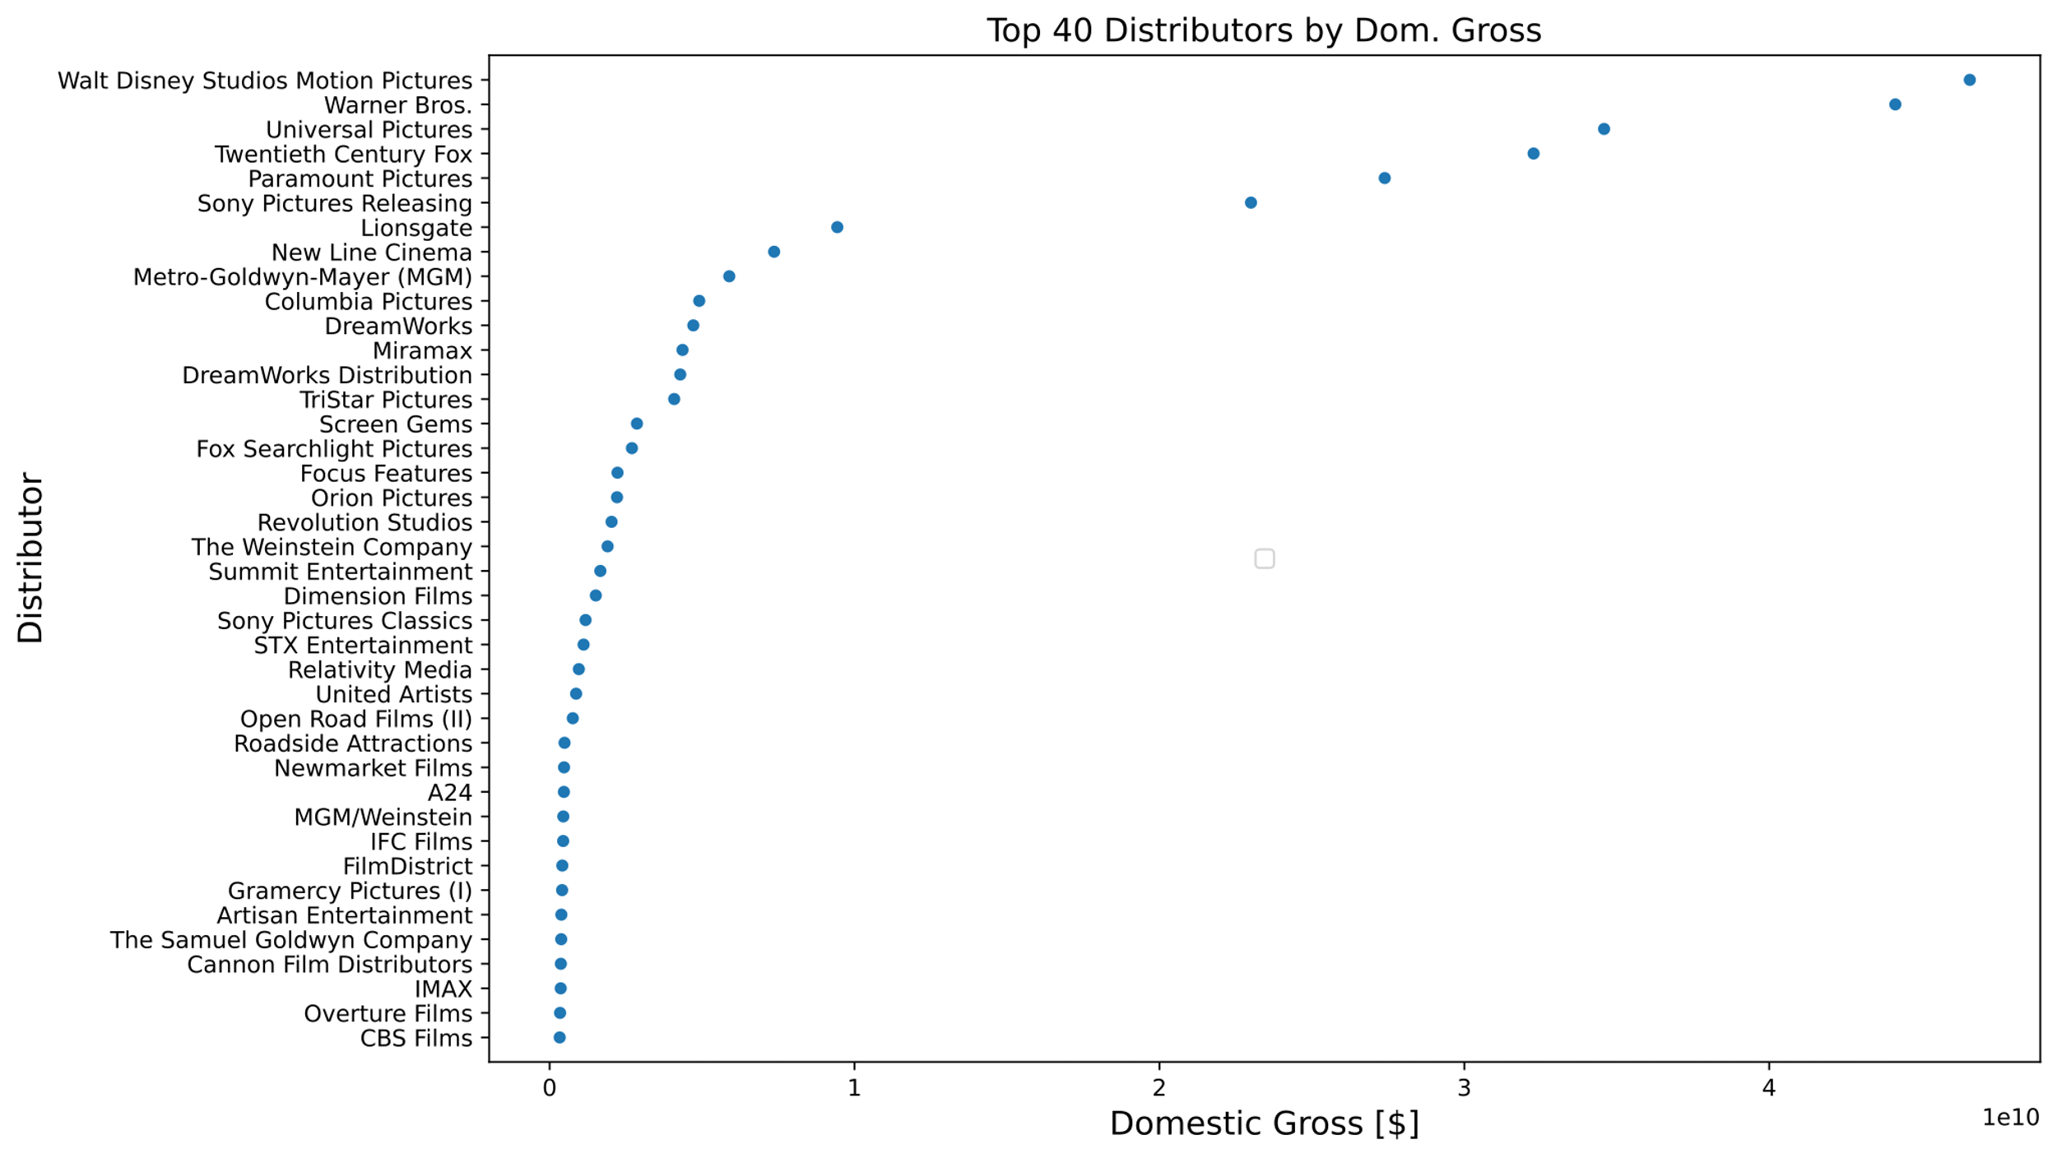

Slide 13
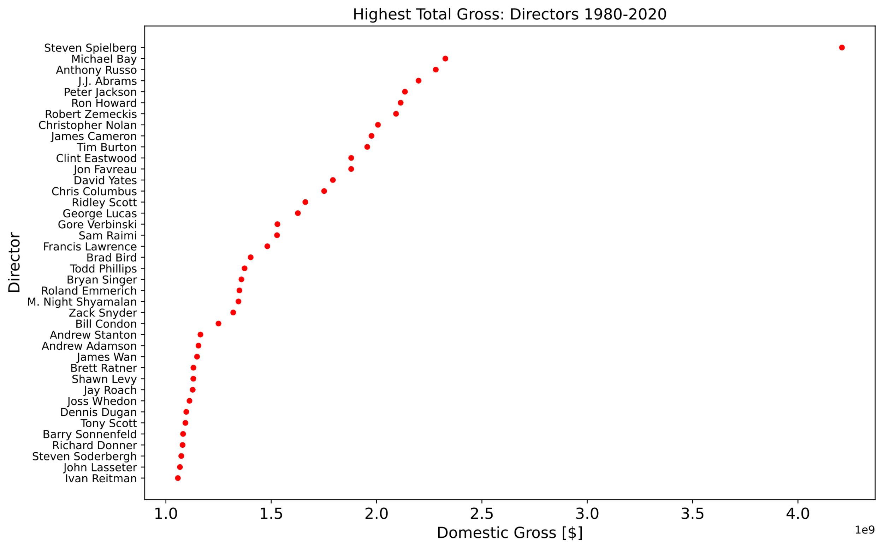

Slide 14
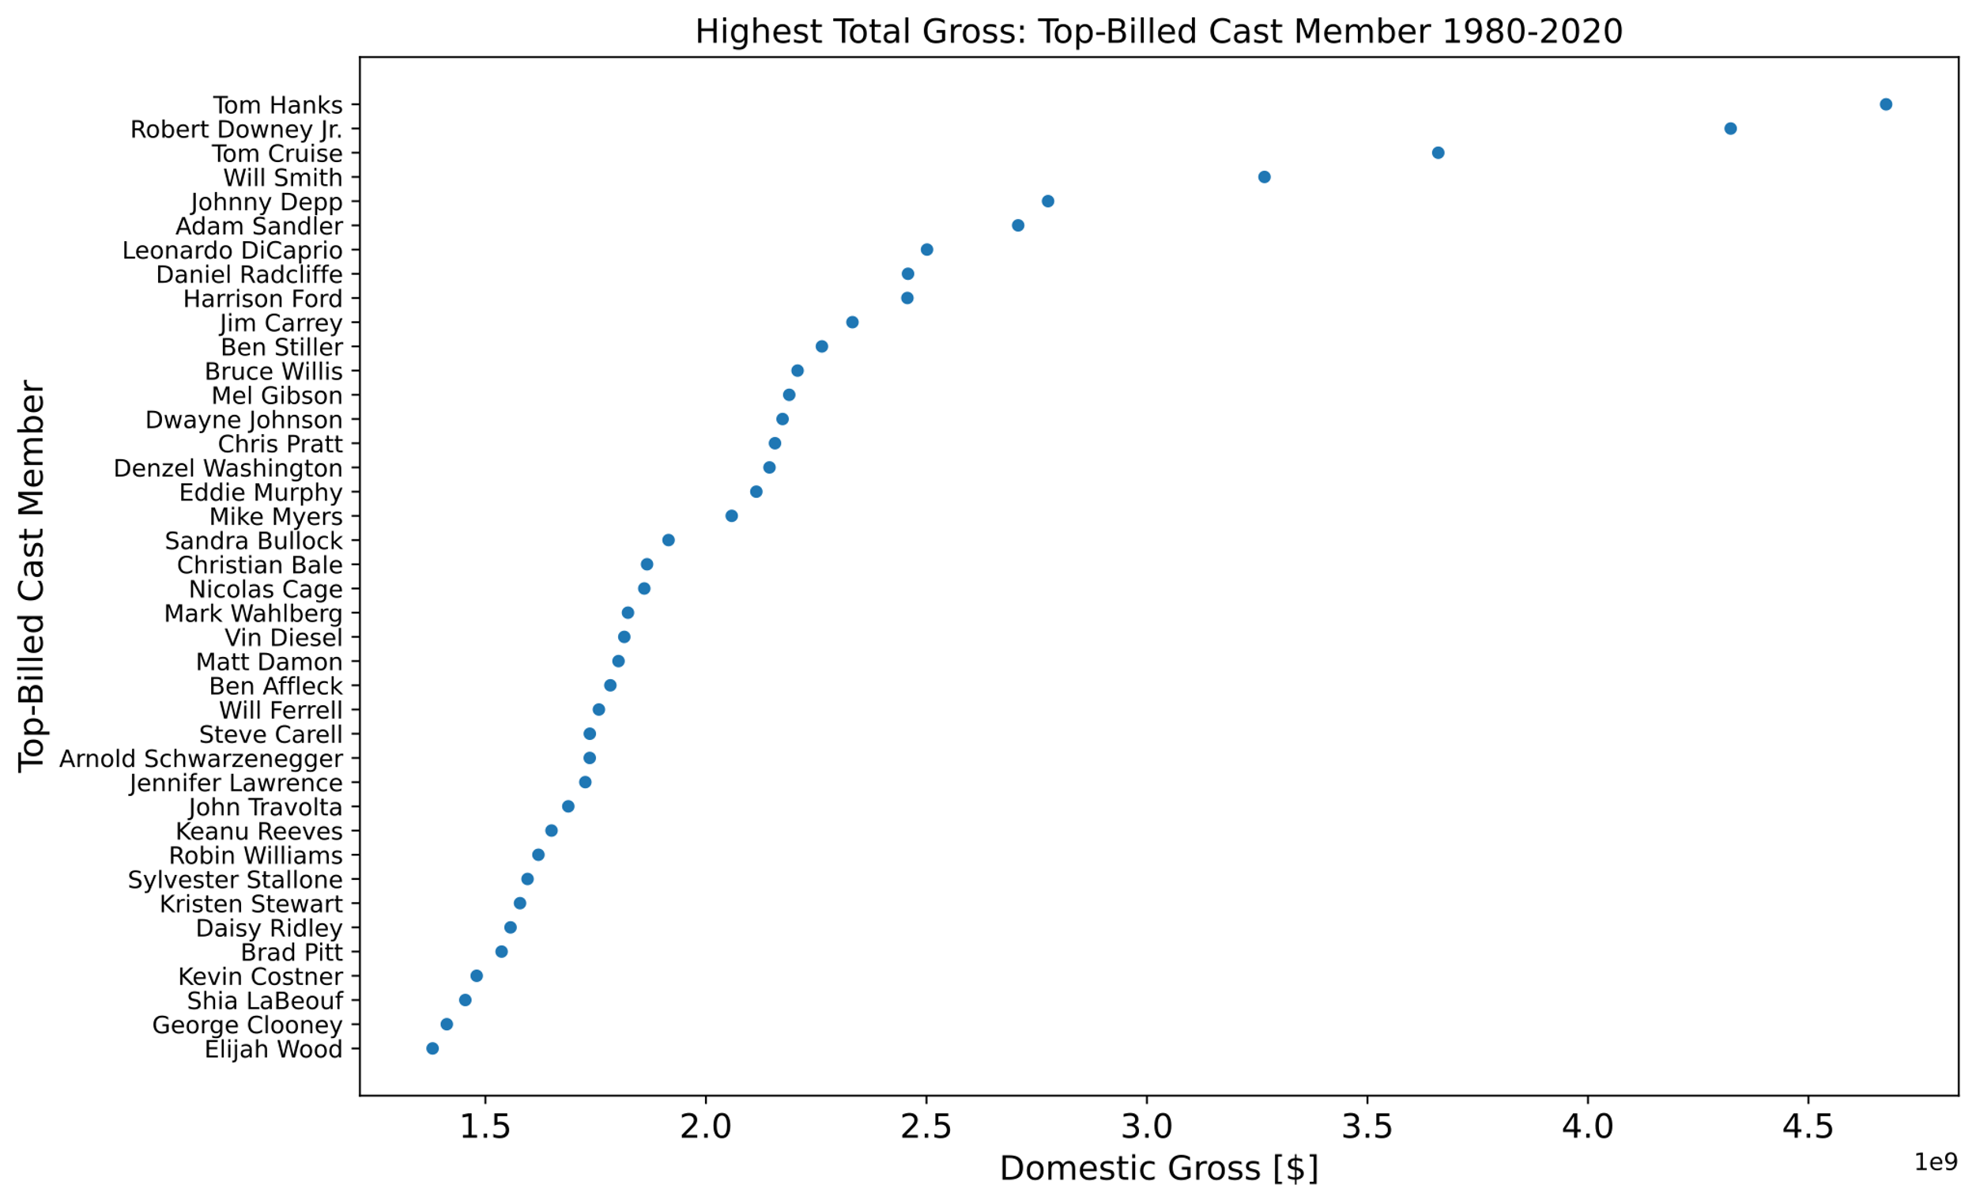

Slide 15
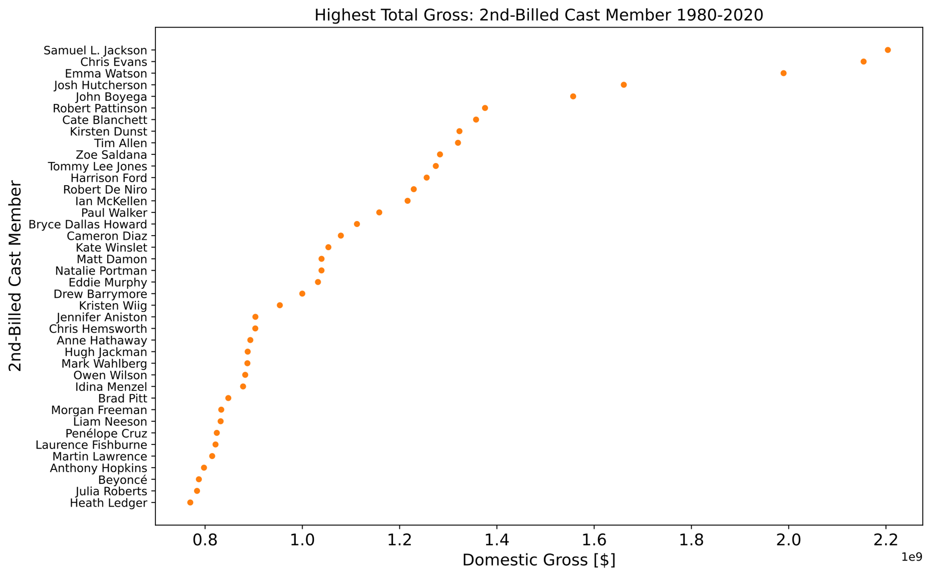

Slide 16
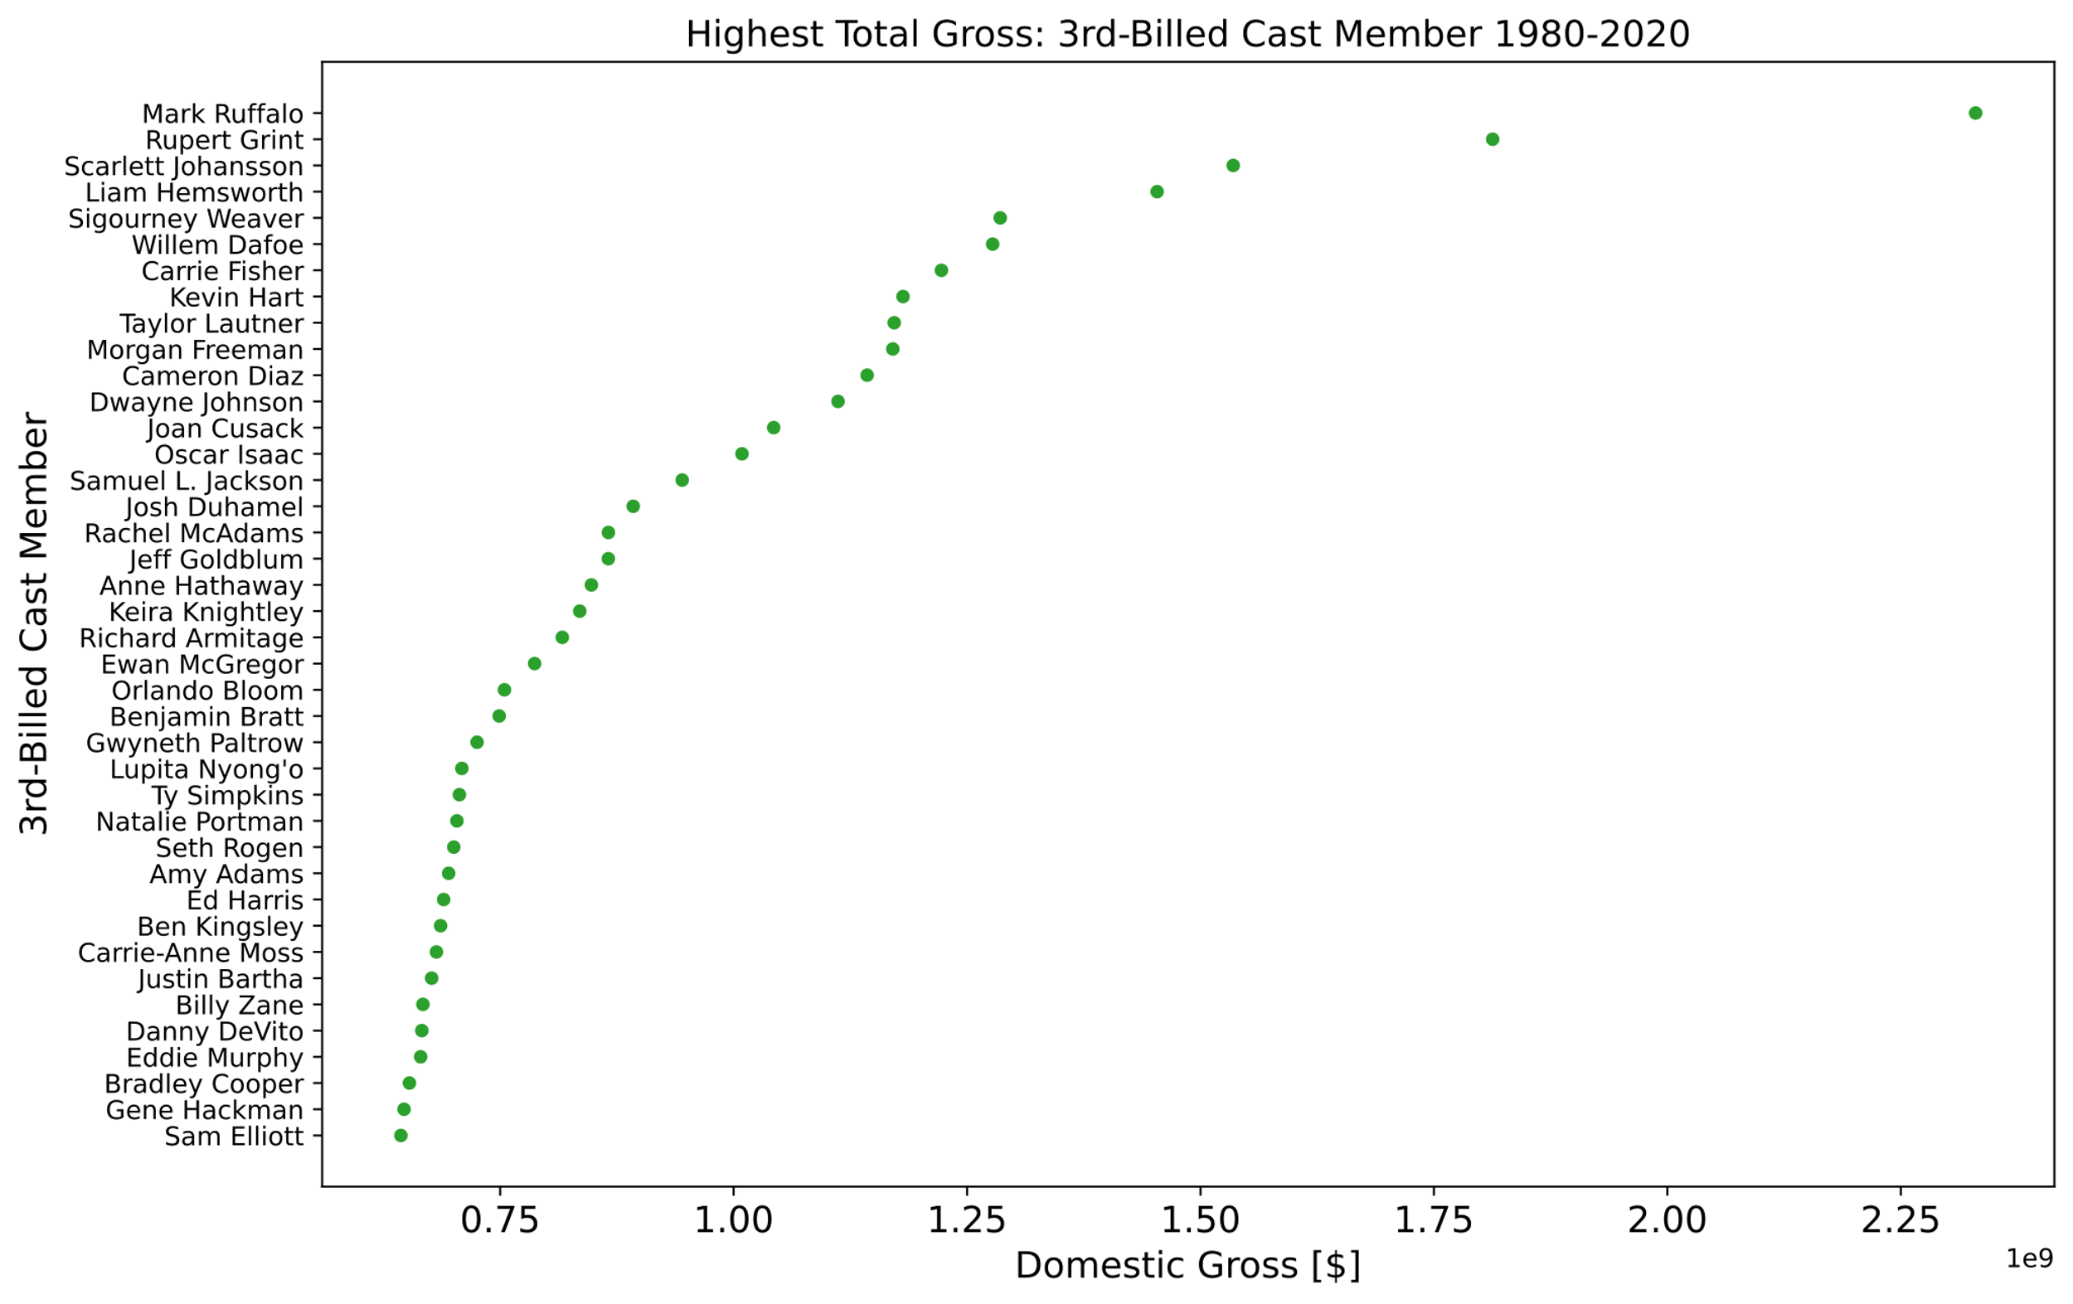

Slide 17
